Slide 1
How Technology Enables a More Cost-Effective Audit Realized by Structuring Analytics to Assertions
by
Rob Nehmer (nehmer@oakland.edu)
Hans Weigand (h.weigand@uvt.nl) and
Philip Elsas (philipelsas@computationalauditing.com)
WCARS 44 Sevilla, Es. March 21, 22 2019
1

Slide 2
PCAOB Section 329A.02
Analytical Procedures
Analytical procedures are an important part of the audit process and consist of evaluations of financial information made by a study of plausible relationships among both financial and non-financial data. Analytical procedures range from simple comparisons to the use of complex models involving many relationships and elements of data. A basic premise underlying the application of analytical procedures is that plausible relationships among data may reasonably be expected to exist and continue in the absence of known conditions to the contrary.
WCARS 44 Sevilla, Es. March 21, 22 2019
2

Slide 3
PCAOB Recently Identified Deficiencies in Performing Analytical Procedures
Including failure to…
Develop appropriate expectations
Establish threshold for differences without further investigation
Establish threshold for differences to achieve sufficient level of assurance
Test data used in analytical procedure
Investigate unexpected differences
WCARS 44 Sevilla, Es. March 21, 22 2019
3

Slide 4
AU 329A Continues…
The expected effectiveness and efficiency of an analytical procedure in identifying potential misstatements depends on, among other things
the nature of the assertion
the plausibility and predictability of the relationship
the availability and reliability of the data used to develop the expectation
the precision of the expectation.
WCARS 44 Sevilla, Es. March 21, 22 2019
4

Slide 5
AU 329A Continues…
Investigation and Evaluation of Significant Differences
In planning the analytical procedures as a substantive test, the auditor should consider the amount of difference from the expectation that can be accepted without further investigation. This consideration is influenced primarily by materiality and should be consistent with the level of assurance desired from the procedures. Determination of this amount involves considering the possibility that a combination of misstatements in the specific account balances, or class of transactions, or other balances or classes could aggregate to an unacceptable amount.
WCARS 44 Sevilla, Es. March 21, 22 2019
5

Slide 6
Our proposal
We model the plausible relationships among both financial and non-financial data for substantive testing but also for control assessment
A few non-financial (quasi-)goods are required to be reliably recorded as a control measure
These control measures on (quasi-)goods are tested (assessed) on design, implementation and uninterrupted operation
The client’s reliably monitored (quasi-)goods are used to set expectations for FS amounts to be reported through their relationships with those FS amounts
WCARS 44 Sevilla, Es. March 21, 22 2019
6

Slide 7
Auditability definition
What is auditing for?
Answer: assurance on financial reporting to owner and potential owner / society at large
What is needed to make auditing more meaningful?
Answer: control infrastructure (CI)
What must be auditable in the first place?
Answer: Financial Statements (FS)
What must be auditable after CI is in place?
Answer: IT system, Information System in Enterprise System (ES)
WCARS 44 Sevilla, Es. March 21, 22 2019
7

Slide 8
Two cycles
Agency cycle: principal (owner) → enterprise, including management → auditor → owner
CI Design cycle: society (CI req) → auditing professional community (CI design) → company (CI implementation + use)→ auditor (CI assessment) → society
Two design problems:
require
Control infrasructure
require
Audit method
Auditable
ES + ITS + IS
(Basis for)
Assurance
ES
WCARS 44 Sevilla, Es. March 21, 22 2019
8

Slide 9
CI as an artefact consisting of several layers
Key controls
SoDs
Control driver
reliability based on
location based on
implementation realized by
Industry type blueprint
IT infrastructure
composed of
Internal systems
Externally controlled systems
External
systems
Top Value cycle
control cycle
exchange cycle
WCARS 44 Sevilla, Es. March 21, 22 2019
9

Slide 10
CI anchor points (within the Enterprise System)
Top value cycle – integration of physical or service flow with financial flow (business process model)
Present in all market Enterprises (but physical flow can be marginal)
Control cycle
Present in all multi-agent Enterprise
Exchange cycle
Embedded in value cycle
Traditionally only partially visible (dependent view). Can become visible with Shared Ledger blockchain or other externally located platforms (e.g. booking site)
3 cycles used in industry blueprint
WCARS 44 Sevilla, Es. March 21, 22 2019
10

Slide 11
CI drivers
Self-interest
What can be supposed to be reliable in self-reporting?
Other-interest
What can be supposed to be reliable in the reporting of related agent (next agent in the cycle)
Common interest
4-eyes principle
No interest
External observer (expensive)
Technology (under responsibility of external party)
WCARS 44 Sevilla, Es. March 21, 22 2019
11

Slide 12
CI conceptual design
Exploit consistency relationships in the cycles
Check consistency: analytical procedures, assertion-based (during audit)
Design and optimize control infrastructure (during design time):
Select key controls from such that other variables can be derived!
Define minimal Segregation of Duties!
Key controls
Preferably at beginning of physical flow
SoD
Can be validated by fraud scenario analysis (Pacioli)
WCARS 44 Sevilla, Es. March 21, 22 2019
12

Slide 13
CI technical design
Internal activities, internal control
Authentication/authorization mechanisms, securely supported by e.g. IT controls
Internal activities, external control
Sensors, securely supported by e.g. “heart-beat” mechanisms
Trace good (e.g. tags)
Trace place (e.g. movement sensor; entrance control)
Trace physical activity (e.g. camera)
External activities, external control
Transaction recordings, securely supported by e.g. tamper-proof storage
Trace exchange transactions (e.g. blockchain)
Trace ordering cycle (e.g. external reservation system)
Trace customer use (e.g. barcode sealing)
WCARS 44 Sevilla, Es. March 21, 22 2019
13

Slide 14
IT System (ITS) components – internal systems
Internal systems
System
management
system access
applications
(processing)
storage
system
network
IT key controls
(ITS auditability
design)
e.g. logging
network monitoring
WCARS 44 Sevilla, Es. March 21, 22 2019
14

Slide 15
IT System (ITS) components – externally controlled internal systems
Externally controlled systems
System
management
device
(recording)
IoT service
(processing)
storage
system
network
or
IT key controls
(ITS auditability
design)
e.g.
heart-beat
mechanism
tag
sensor/
effector
camera
WCARS 44 Sevilla, Es. March 21, 22 2019
15

Slide 16
AS 2110: Identifying and Assessing Risks of Material Misstatement
Performing Risk Assessment Procedures Includes
Obtaining an understanding of the company and its environment
Obtaining an understanding of internal control over financial reporting
Performing analytical procedures
Inquiring of the audit committee, management, and others within the company about the risks of material misstatement
WCARS 44 Sevilla, Es. March 21, 22 2019
16

Slide 17
Performing Analytical Procedures
Purpose
Identify areas that might represent specific risks relevant to the audit, including the existence of unusual transactions and events, and amounts, ratios, and trends that warrant investigation
In applying analytical procedures as risk assessment procedures, the auditor should perform analytical procedures relating to revenue with the objective of identifying unusual or unexpected relationships involving revenue accounts that might indicate a material misstatement, including material misstatement due to fraud.
WCARS 44 Sevilla, Es. March 21, 22 2019
17

Slide 18
Performing Analytical Procedures
Application:
When performing an analytical procedure, the auditor should use his or her understanding of the company to develop expectations about plausible relationships among the data to be used in the procedure.
When comparison of those expectations with relationships derived from recorded amounts yields unusual or unexpected results, the auditor should take into account those results in identifying the risks of material misstatement.
WCARS 44 Sevilla, Es. March 21, 22 2019
18

Slide 19
Modified Audit Risk Model
The auditor develops analytics based on the client’s top cycle
After identifying the relevant assertion in the value (money) cycle, such as completeness, the auditor tests for corresponding CI controls in the goods stream (control design, implementation and operation)
Activity levels in these controls/sensors are set at the levels which correspond to external/client-recorded non-financial (quasi-)goods that offer proxy relationships to expected FS values
WCARS 44 Sevilla, Es. March 21, 22 2019
19

Slide 20
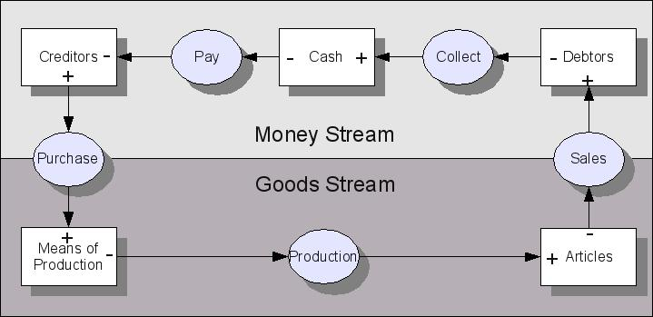
Revenue completeness assertion
Control or sensor under an external party with a metric
Assertion vs. Analytic

Slide 21
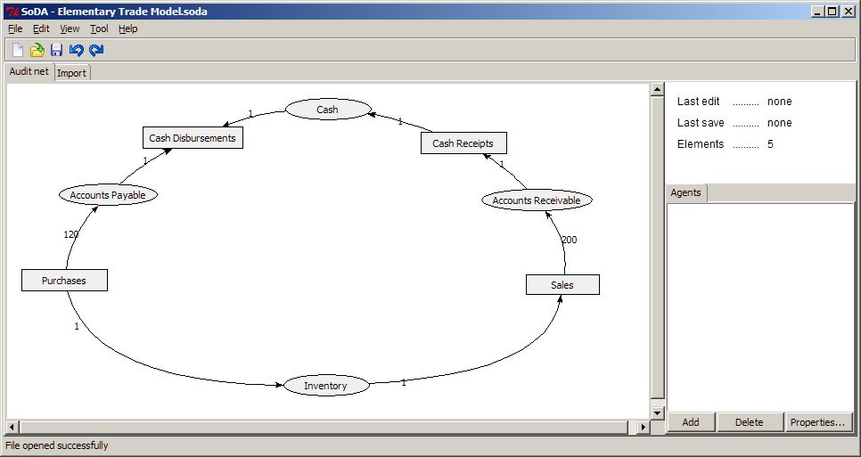
Assertion
Control metric
Smart flow chart
21

Slide 22
Developing Analytics from the Value Chain
The auditor can focus on relationships representing the client’s business model under risky conditions
These conditions include:
parameters which historically have experienced relatively large fluctuations
parameters which might be expected to have fluctuations in the current period due to perturbations in the client’s business model or business environment
WCARS 44 Sevilla, Es. March 21, 22 2019
22

Slide 23
Developing Analytics from the Value Chain
Three conditions can be used to constrain the use of this approach for developing analytic procedures during the planning stage of the audit process:
Looking for conditions where the analytics will hold,
Focus on audit risks and their related assertions either in the clients business model or their business context, and
Focus on associated control parameters which experience variability in their measures in association with the audit risk measure within the audit period or across audit periods.
WCARS 44 Sevilla, Es. March 21, 22 2019
23

Slide 24
Use in the Audit Process: An Extended Example
Consider a hotel
Say that there is a reservation system which is controlled by one or more external service providers, Booking.com and Hotels.com
There are various sensors in the hotel room: motion detectors, electronic entry, windows sensors, entertainment system, HVAC system etc.
Some of the sensors must capture data that can be retrieved at a later time
WCARS 44 Sevilla, Es. March 21, 22 2019
24

Slide 25
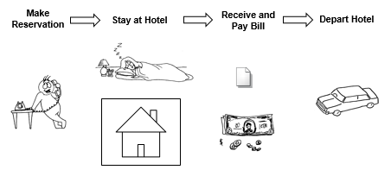
Assertions, CI and Analytics
Reservation System
Room Sensors
Existence Assertion

Slide 26
Use in the Audit Process
Hotel example:
Part of the business model is the collection of sales revenues from paying customers.
The auditor may be concerned that their client could over report revenues.
The assertions involved are the existence of the revenues reported.
WCARS 44 Sevilla, Es. March 21, 22 2019
26

Slide 27
Use in the Audit Process
Auditors should consider:
The existence of external parties, the booking agencies, which are capturing the quasi-good reservations.
The existence of the records of the room control devices, especially for room rentals which originate directly at the hotel chain itself.
The level of risk (variability) acceptable in their association of the control measures and the revenue assertion.
WCARS 44 Sevilla, Es. March 21, 22 2019
27

Slide 28
Use in the Audit Process
The auditor can then set up an analytic modelling this situation:
Looking at reservations booked through the external parties
The changes in the behavior of the rooms’ control devices as evidenced by their measures (use of entertainment system, room temperature, etc.)
The reported revenue.
The precision of the estimate (range of acceptability)
WCARS 44 Sevilla, Es. March 21, 22 2019
28

Slide 29
Use in the Audit Process
In the Planning Stage of the Audit:
The auditor plans to collect evidence from the booking agencies and the suitable control devices during the substantive phase of the audit
The auditor will use this approach to help plan the procedures to perform during the audit
So the three conditions are met:
Looking for conditions where the analytics will hold,
Focus on audit risks and their related assertions either in the clients business model or their business context, and
Focus on associated control parameters which experience variability in their measures in association with the audit risk measure within the audit period or across audit periods.
WCARS 44 Sevilla, Es. March 21, 22 2019
29

Slide 30
Use in the Audit Process
The Substantive Phase
Existence assertion:
Evidence of accounting transactions exist for all revenues booked by the external agencies.
Appropriate measures collected from the chosen control.
Calculation of the revenue amount from the analytics and comparison with the client reported revenue amount.
WCARS 44 Sevilla, Es. March 21, 22 2019
30

Slide 31
Use in the Audit Process
Final Stage of the Audit
The importance of the auditor’s evaluation of any difference at this stage will depend on:
The weight attached to the results of the substantive testing stage
Whether any additional procedures were performed to test the existence assertion
WCARS 44 Sevilla, Es. March 21, 22 2019
31

Slide 32
Summary
We use the plausible relationships among both financial and non-financial data not only for substantive testing but also for control assessment
We showed how this relates to assessment of controls and to analytic procedures in FS audits
We gave an extended example
WCARS 44 Sevilla, Es. March 21, 22 2019
32

Slide 33
Conclusion
We develop a process to help auditors think about specific control assessments and analytical procedures that they can develop
The process allows auditors to establish controls for reliable expectations to be set for analytical procedures
The process also allows auditors to gauge the level of risk (variability) that they will allow in their expectation
WCARS 44 Sevilla, Es. March 21, 22 2019
33

Slide 34
Questions?
WCARS 44 Sevilla, Es. March 21, 22 2019
34

